Slide 1
Chunky Cookies: Smashing Application Aware Defenses
Russell Butturini (@tcstoolhax0r)
BSides Nashville 2017

Slide 2
Quick Intro
-Pen tester at large health insurance company (who I’m not representing here today)
-13 years of a little of everything on the tech side of security (pen testing, web app hacking, firewalls, etc.)
-Author of NoSQLMap
-World’s worst Powerpointer and not a role model for public speaking

Slide 3
Agenda
-Why is this talk important?
-Application Awareness review
-Weaknesses of Application Awareness
-Fireaway: The PoC tool for application aware smashing
-Time for questions/comments

Slide 4
Typical 2017 Pentest Talk
Macro-Office Doc-Phish-Powershell-Pivot-Pivot-Pivot-Escalate-Pivot-Pivot-Escalate-Pivot-Domain Admin-Write Report-Collect Check-Be l33t

Slide 5
“Assume Breach" Mentality
(aka the “We know our patching program will never be 100% and our users will click on stuff they shouldn’t and people will bring in stuff from home and stick it on the network and in our corporate assets so we’re going to try and pour as much water on the dumpster fire to contain it and mitigate the damage as quickly as possible.” mentality.)

Slide 6
Time to Be Creative!
-Show how detective controls (like app awareness) can be bypassed.
-Data exfiltration demonstrations have huge value.
-Help enterprises find out how their “assume breach” controls are working.
Bottom line: Doing things outside the pen test “norm” (i.e. things that always work and make a good report) adds more value and keeps a section of InfoSec alive that is being devalued thanks to snake oil and automated tools.

Slide 7
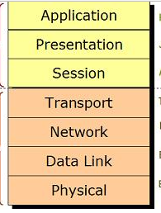
The OSI Model

Slide 8
In the Beginning…
-Looks at traits at layer 3/layer 4 (IP address, port, etc.)
-Simplistic security decisions (permit/deny)
-Examples: Network Firewall, client side firewall, router ACLs, VPNs

Slide 9
Application Awareness
-Can at traits all the way through the OSI model layers, or may be purpose built to only look at data inside the flow.
-Complex security decisions (permit/deny/use external data/QoS/alter payload/rewrite request/user interaction)
-Not reliant on the port to decide on protocol.
-Examples: Application proxies, Next Generation Firewalls, Data Loss Prevention, Anomaly Detection, SSL decryption services, URL filters.

Slide 10
Application Proxies/Next-Gen Firewalls
-Can only hold/inspect for so long before having to let the flow continue to avoid introducing latency.
-Usability and ease of management over security.
-Have to allow some data to flow out before making a decision on whether something matches an application signature.
-Rely on small, limited set of attributes to make a positive match.
-Shortcuts!
-”Anything on port 443 I don’t understand is SSL/TLS”
-Look at the outbound but not the inbound.

Slide 11
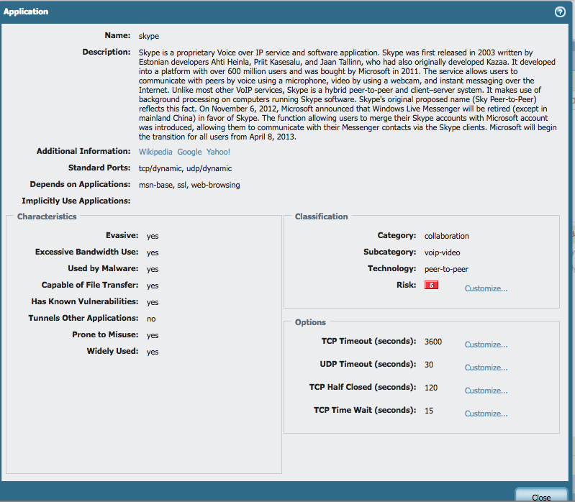

Slide 12
Data Loss Prevention
-Based on static regular expression pattern matching.
-Uses scoring for pattern matches in a flow before stopping anything.
-Trivially defeated by simple encoding (e.g. Base64) .
-Many commercial products will completely ignore small flows.
-Lots of alerts=shelfware.

Slide 13
URL Filtering/Client Side DLP
DECISION IS MADE HERE AND ABOVE!
Notes:
This is true for DLP as well if app definitions are out there.

Slide 14
How about this?
GET /feed/ HTTP/1.1
Host: www.linkedin.com
What-I-Really-Want:www.timewastinggames.com
User-Agent: Mozilla/5.0 (Windows NT 6.1)
Connection: Close

Slide 15
Anomaly Detection Engines
-”Kind of” layer 7 (amounts of data transferred in flows)
-Highly dependent on Layer 3+4 behavior (# of destination IPs/connections, ports, frequency of communications)
-May pull from external sources (Threat intel feeds, DNS recently registered domains, etc.)

Slide 16
Anomaly Detection Engines
-Still reliant on static rules (communications occur above defined or learned thresholds)
-Beatable by introducing randomness! Randomized time intervals for communication, lots of different destinations with irregular communication patterns, masking transmissions inside ”good” applications.

Slide 17
This is where the chunks come in…
-Transmission of data in small pieces to multiple destinations over randomized time intervals.
-App proxies/NGFWs won’t have enough data to make an app based decision.
-Potential for DLP to ignore it (assuming the chunk even matches something it’s looking for at all).
Notes:
This beats everything we’ve talked about!

Slide 18
“Why don’t you just encrypt it?”
Notes:
Remember ‘We know how this guy feels about encryption…” and comments about how encryption arouses suspsicion.
Remember “But at our day jobs…” line

Slide 19
But at our day jobs…
Notes:
Encryption is NOISY! Most protocols involve some kind of key exchange or handshake setup that tips your hand that encryption is in use.
Encryption also makes for a bad PoC for tools that aren’t built to understand it…If they can’t read it, what does encrypting something really prove?

Slide 20
Fireaway 0.2
-Available at https://github.com/tcstool/fireaway
-Original tool presented at Derbycon 6.0, but completely rewritten for this talk.
-Python based PoC tool for bypassing layer 7 controls and DLP using varying levels of complexity.

Slide 21
Test Data Mode
-Send randomly generated data in incrementally larger sizes across a multiple flows.
-Great for testing NGFW data leakage when layer 7 rules are blended with layer 3+4 rules.

Slide 22
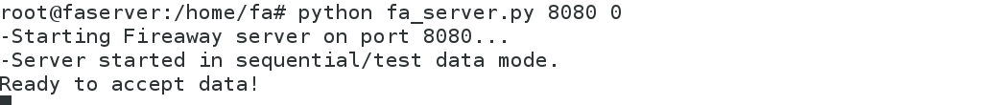
Test Data Server Setup

Slide 23

Test Data Client Setup

Slide 24
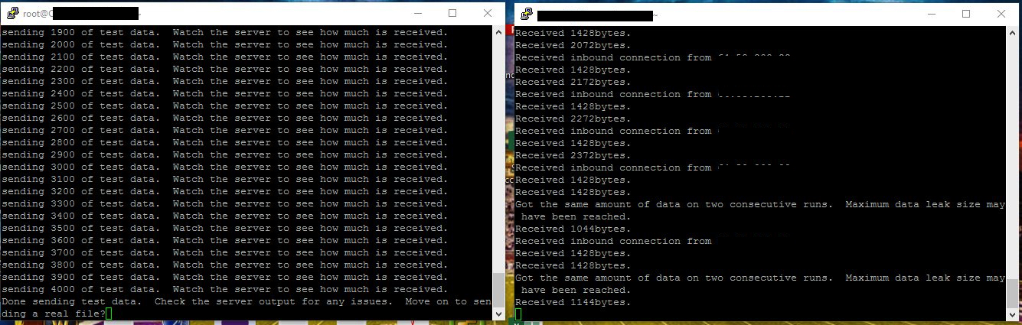

Slide 25
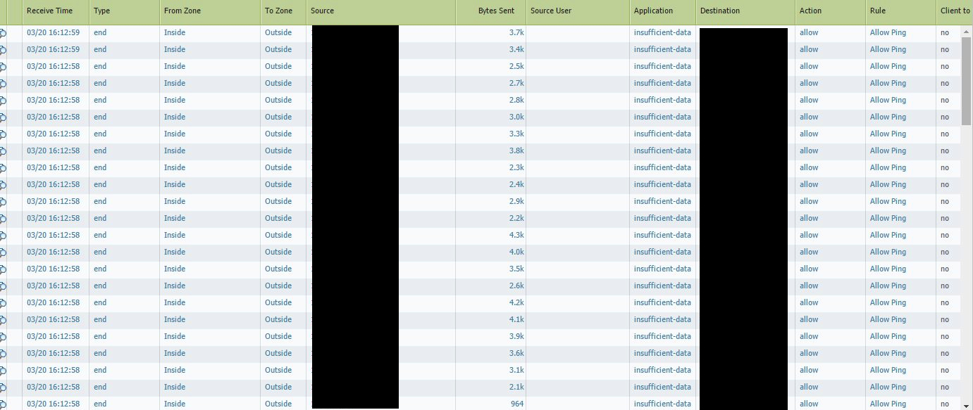
Notes:
So basically we set up a server on a port not allowed out through other firewall rules

Slide 26
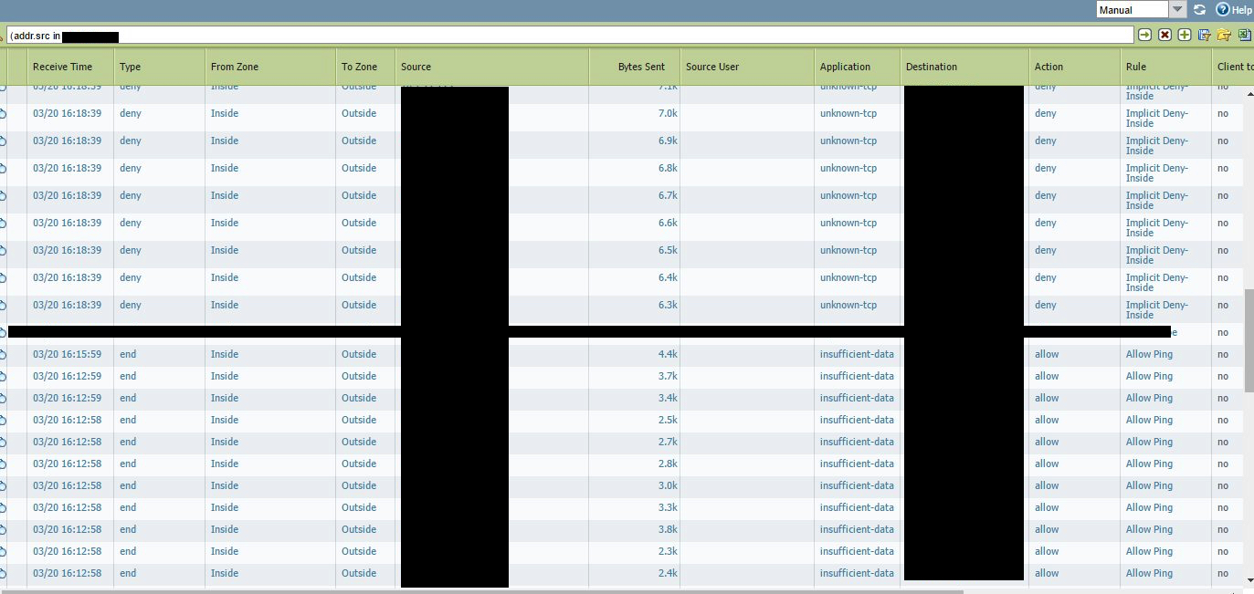

Slide 27
Sequential Data Chunking Mode
-Tests the ability of DLP to fire on small chunks of data.
-Sequentially transmits pieces of a file across multiple flows to one or more servers.
-If data is bleeding in small units across closed ports, this may fall outside SOC monitoring scope!

Slide 28
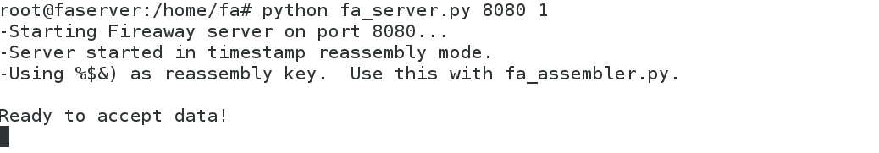
Data Chunking Server Setup

Slide 29
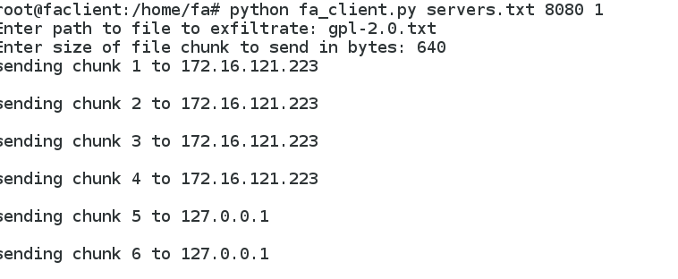
Data Chunking Client Setup

Slide 30
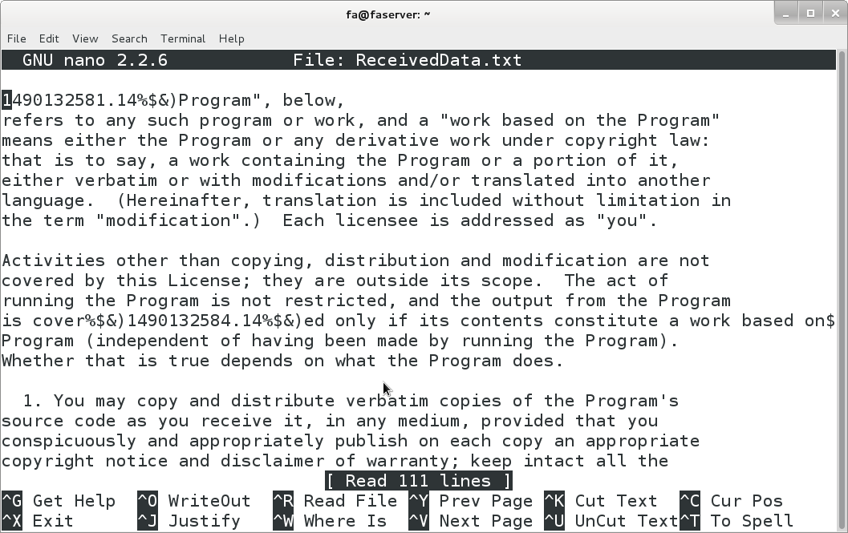

Slide 31
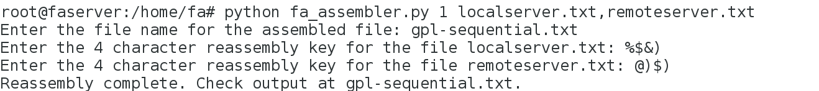
Reassembling Our Example

Slide 32
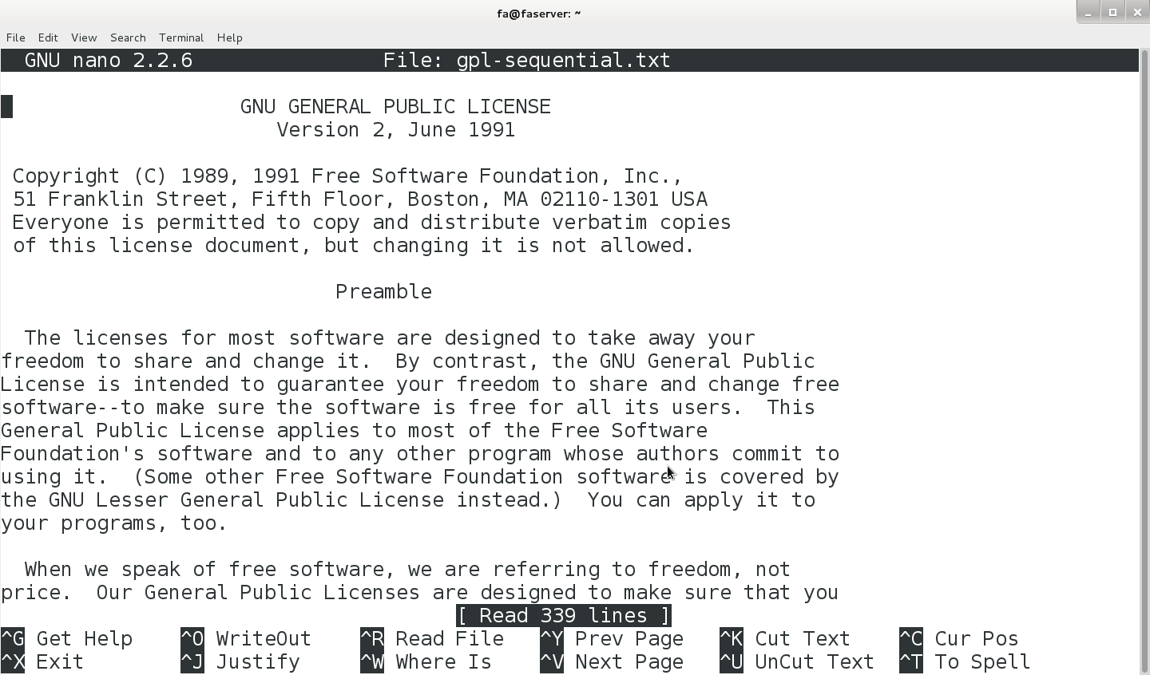

Slide 33
OK Great, but…
-Sending data sequentially can be picked up (but spacing across multiple flows and multiple servers helps).
-Network DLP that assembles multiple flows together could trigger.

Slide 34
Random Data Chunking Mode (“Reverse Bittorrent”)
-Instead of transmitting sequentially, transmit pieces randomly.
-Imagine combining this with encoding! (Base64 anyone?)
-Need to describe the order data will be pushed in.
-Once the data is out, we can do as much work as we need to on the outside without being detected.

Slide 35
Sequence Key
17n18U10H51C34Y0N58$1K47n21a52C40*54P4J3U11V31p37l5#32s7Z9K15G35#2D8G48n50C23B41d45W60z30t16G44Y26T25o59l46H38F36T55M43A53q33$29t24$12t39n49E20S27(14B22m19V13u42Y28S6P57A56B

Slide 36
Sequence Key
17n18U10H51C34Y0N58$1K47n21a52C40*54P4J3U11V31p37l5#32s7Z9K15G35#2D8G48n50C23B41d45W60z30t16G44Y26T25o59l46H38F36T55M43A53q33$29t24$12t39n49E20S27(14B22m19V13u42Y28S6P57A56B

Slide 37
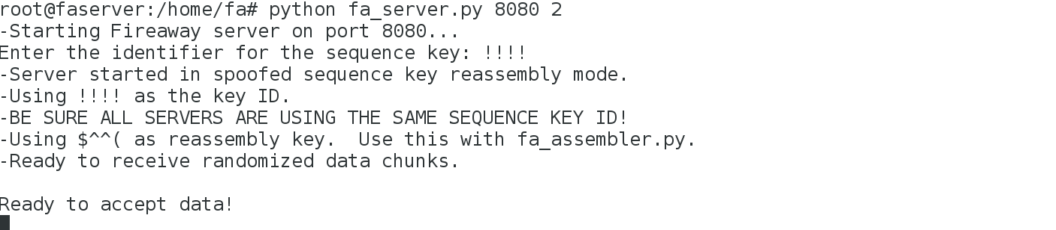
Random Data Chunk Server Setup

Slide 38
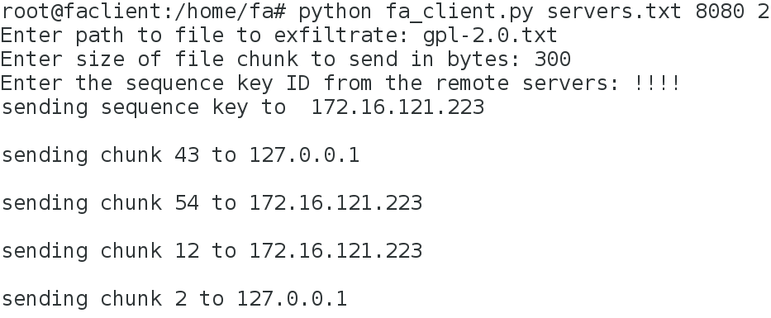
Random Data Chunk Client Setup

Slide 39
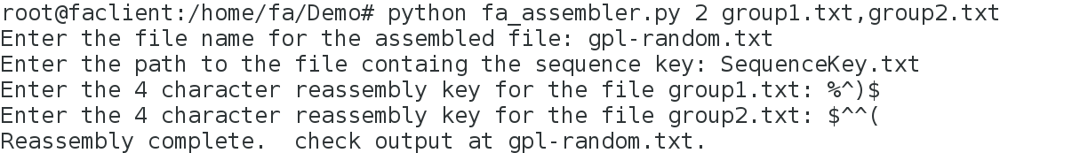
Random Chunk Reassembly

Slide 40
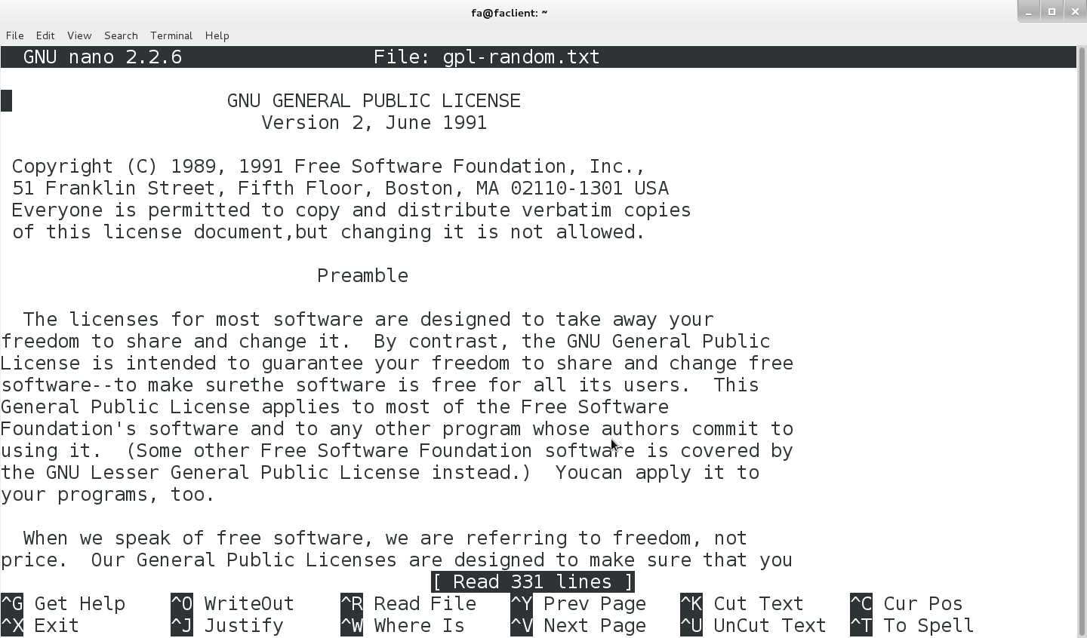

Slide 41
A little better, but…
-Still not really inconspicuous what’s happening if the chunk size is large enough.
-Can we use the same concepts but hide in plain sight to our detection systems?

Slide 42
App Spoofing
-Let’s assume our layer 7 controls understand what’s happening at layers 7 and 4, but give no regard to layer 3 (i.e. WHERE the flow is going).
-What happens if we send a “good” app to a bad place?

Slide 43
So what if we send this to our evil IP?
GET / HTTP/1.1
Host: www.linkedin.com
User-Agent: Mozilla/5.0 (Windows NT 6.1)
Connection: Close
We can even put some data here since the firewall doesn’t care about malformed requests!
Notes:
Web apps are great things to spoof.

Slide 44
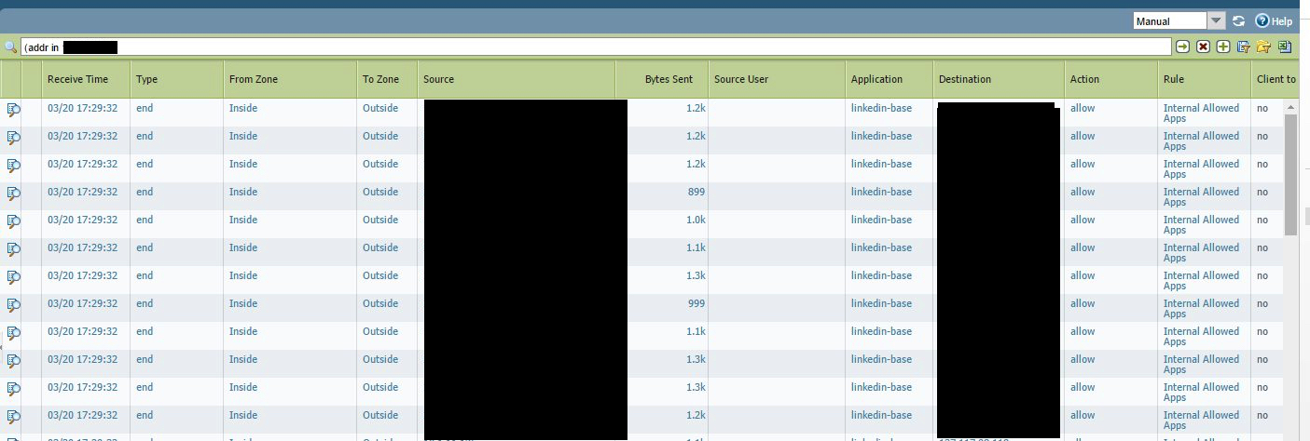

Slide 45
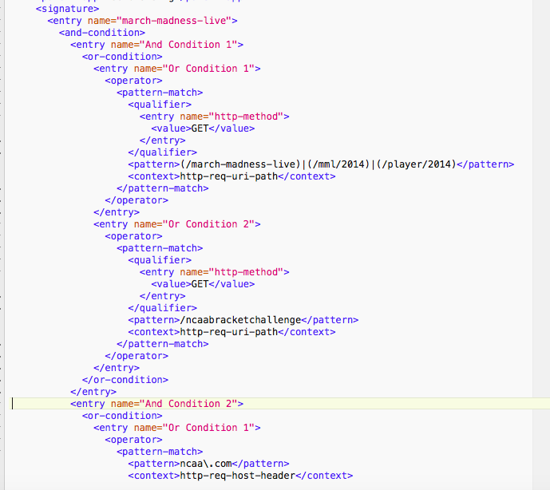

Slide 46
HTTP Based Application Spoofing Mode
-Inserts randomly named HTTP headers with ”chunks” of Base64 encoded data inside requests that look like safe applications.
-The entire file is Base64 encoded first, and only pieces of the specified chunk size are transmitted in a single request, so the entire file is never seen at once!
-Can handle text, binary files, images, etc.

Slide 48
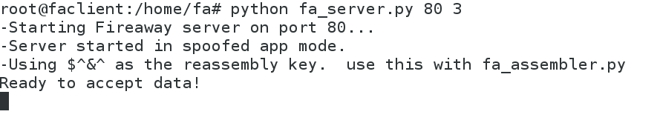
App Spoofing Server Setup
-

Slide 49
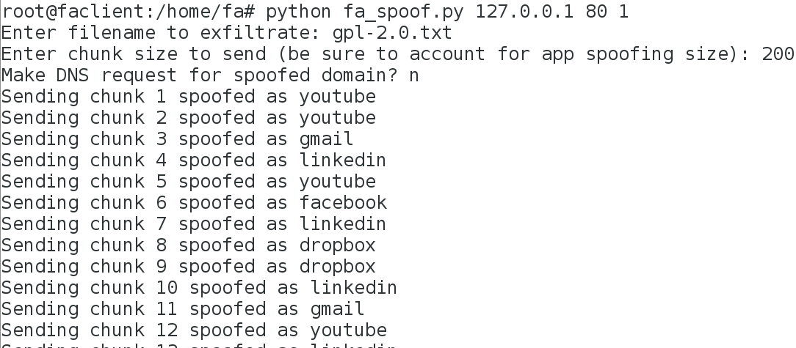
App Spoofing Client Setup

Slide 50
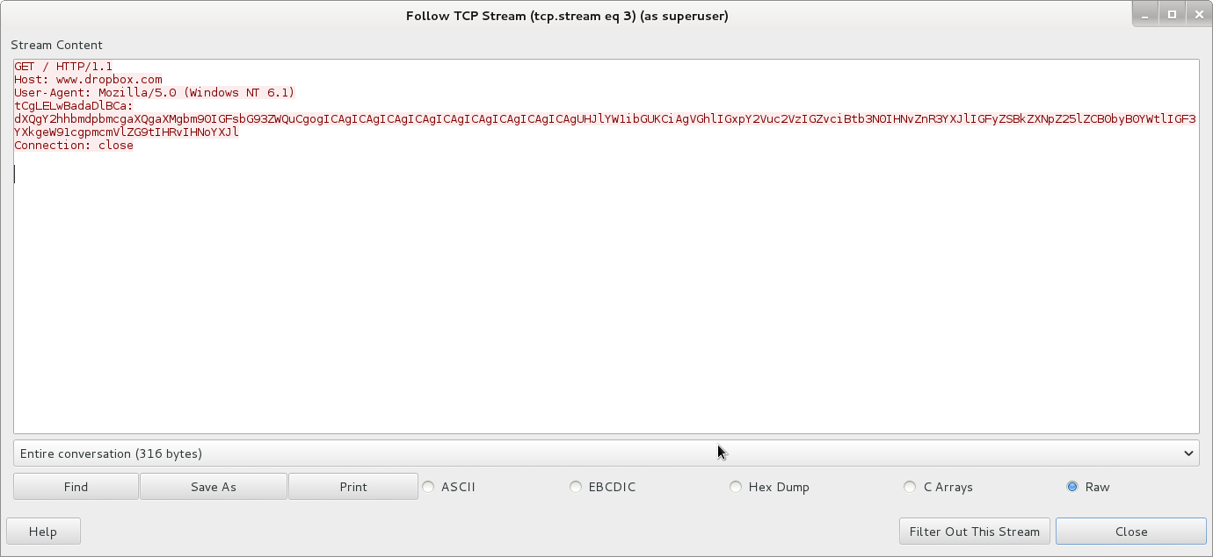

Slide 51
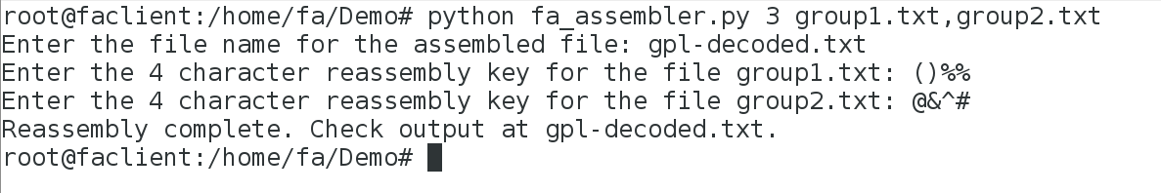

Slide 52
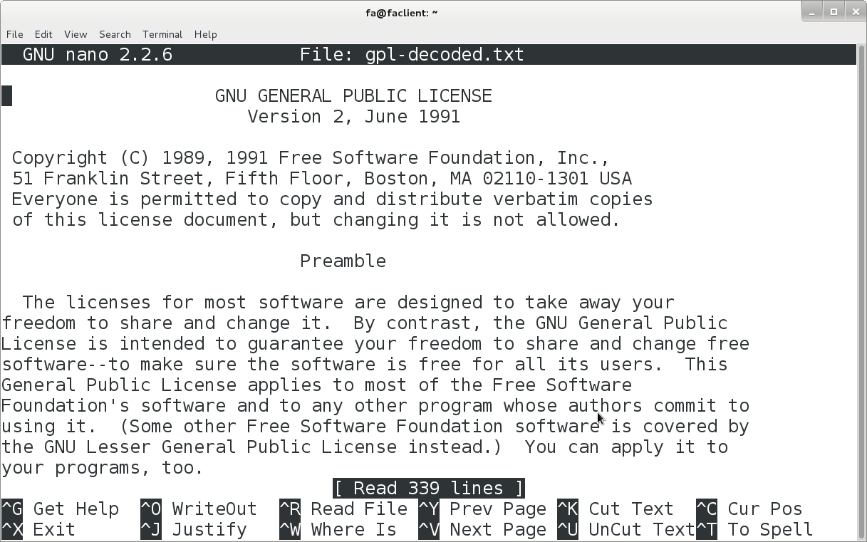

Slide 53
App Spoofing
-At no point is the data seen in its entirety on one flow for analysis.
-Looks like good apps.
-Fireaway limitations: Incongruent response sizes (lots of out, only control traffic back in), same IP can have different apps spoofed at it, raising alarms, not enough variance in the pages requested.
-Still a good PoC!

Slide 54
So that’s out, but what about in?
-Scenario 1: A client machine makes a bunch of outbound HTTP-like requests that look good applications (facebook, linkedin, etc.) to different servers. The servers send back (either alone or in the body of cloned pages as HTML comments or whatever) pieces of encoding/encryption which the client then has logic to reassemble in order.
-Scenario 2: A compromised client makes legitimate app requests out to bad IPs, which send back cloned pages with minor additional content (C&C channel instructions, JavaScript to download more malware, etc.)

Slide 55
That’s it!
Fireaway: https://github.com/tcstool/fireaway
Questions/Comments: @tcstoolhax0r
References:
”Network Application Firewalls Exploits and Defense” Brad Woodberg, Defcon 19
”Bypassing Next-Gen Firewall Rules” Dave Lassalle, Nolasec 9/27/2012

